Slide 1
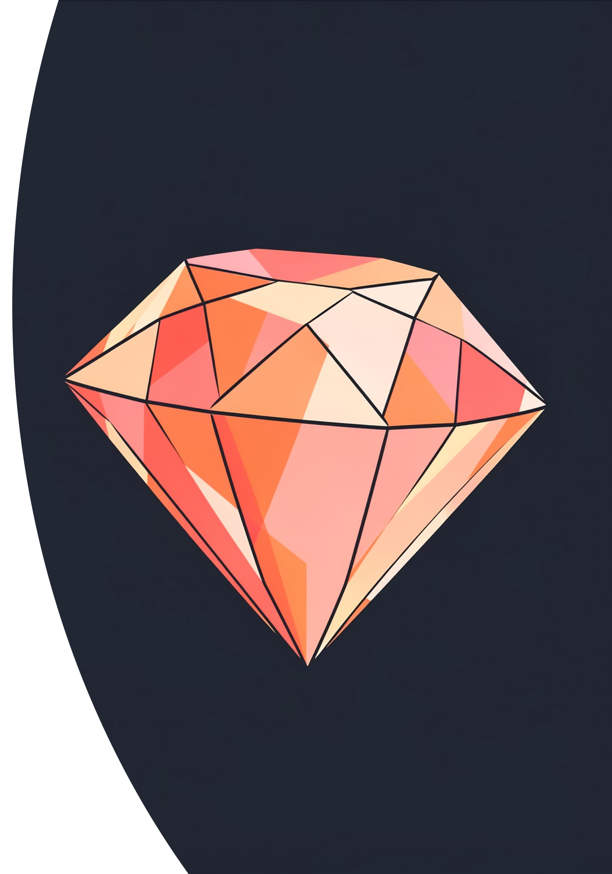
Diamond Grader: Gem Valuator
Team Members: Sahana, Nivedita N., Nivedita K., Chetana

Slide 2


CHALLENGE
Problem Statement
The Challenge
Accurate valuation of diamonds is critical for fair pricing and consumer trust in the jewelry market. Current manual grading methods are time-consuming, subjective, and prone to human error.
Our Objective
Develop a predictive model to automate diamond grading and valuation with high precision, bringing consistency and speed to gem evaluation.

Slide 3
DATA
Dataset Overview
50,000+ Records
Key Attributes
Quality Source
Comprehensive collection of natural diamonds with verified grading labels
Carat, cut, color, clarity, depth, table, dimensions, and price
Publicly available datasets ensuring reliability and authenticity
Our dataset combines both numeric features (carat weight, measurements, depth percentages) and categorical features (cut quality, color grade, clarity rating) that are essential for accurate diamond valuation. This rich feature set enables our models to capture the complex relationships that determine a diamond's true worth.

Slide 4
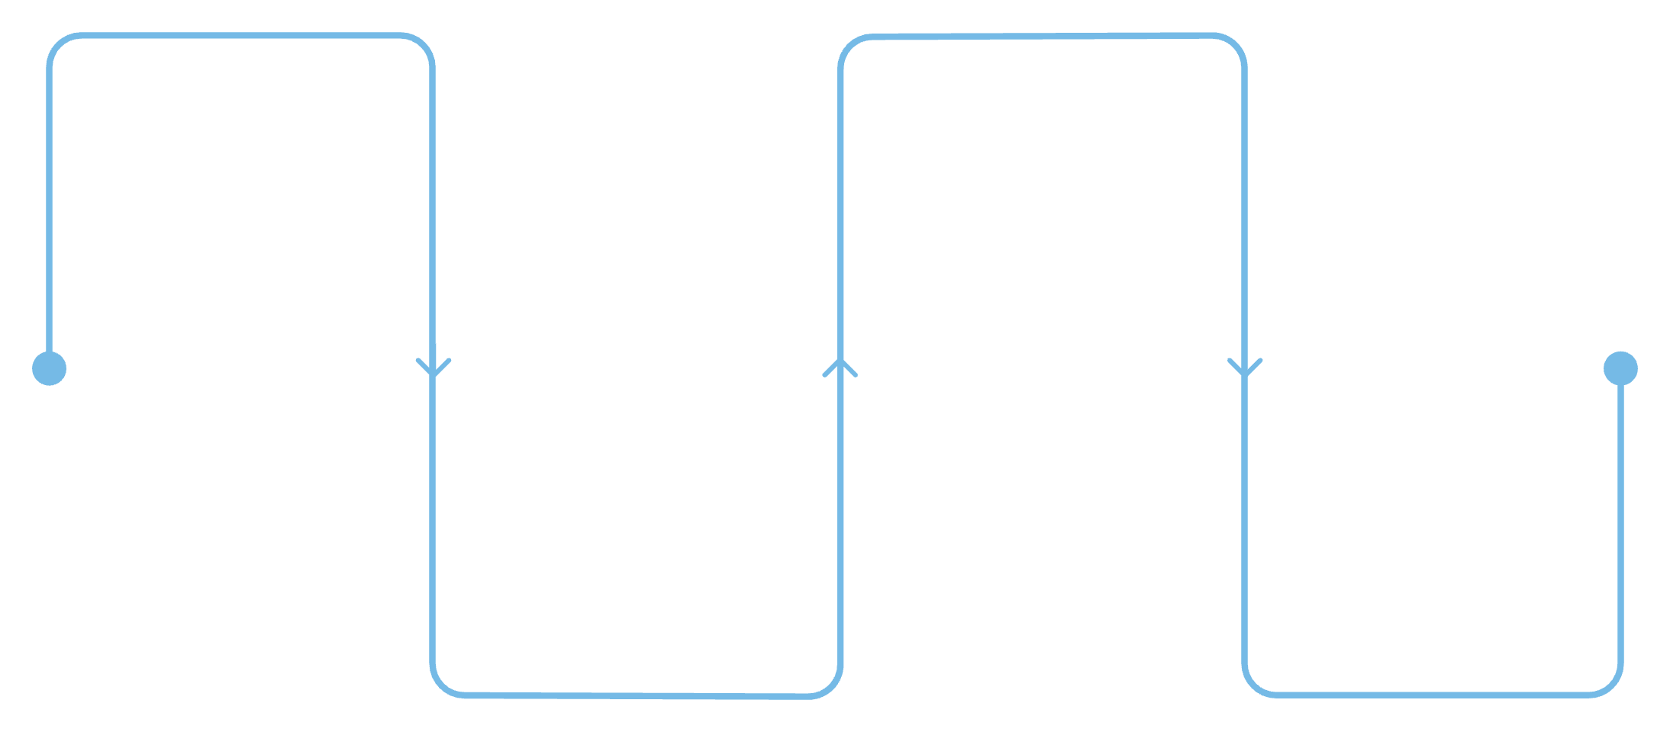
PREPROCESSING
Data Preprocessing Pipeline
Key Steps
Clean Data
Scale Values
Handle missing values and outliers
Normalize or standardize features
Data Cleaning: Handling missing values and removing outliers to ensure dataset integrity
Encoding: One-hot encoding applied to categorical variables (cut, color, clarity)
Scaling: Feature normalization for numeric attributes to optimize model performance
Splitting: 80/20 train-test split for robust model evaluation
Encode Features
Convert categorical data to numeric
Split Dataset
Divide into train, validate, test
Our systematic approach ensures data quality and model readiness through careful transformation and validation at each stage.

Slide 5
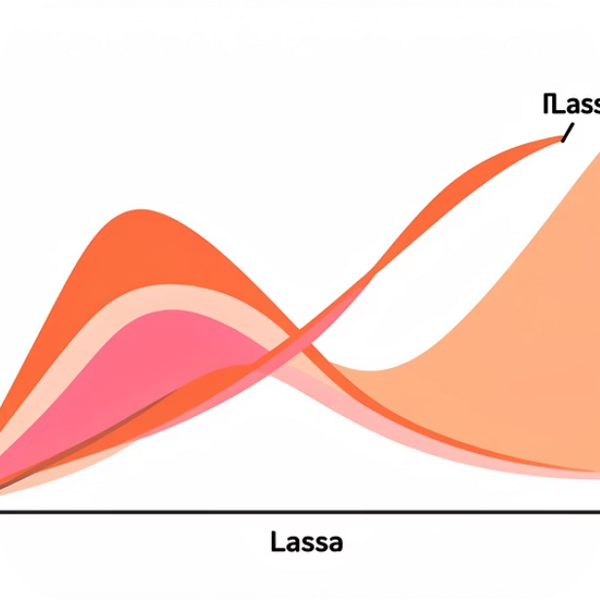

MODELING
Model Building Approach
Regularization Models
Random Forest
Ridge and Lasso regression techniques prevent overfitting while identifying the most important features for diamond valuation
Ensemble learning method captures nonlinear relationships and complex feature interactions inherent in diamond pricing
Hyperparameter tuning via cross-validation was applied to both model families to optimize performance and ensure generalization to unseen diamond data.

Slide 6
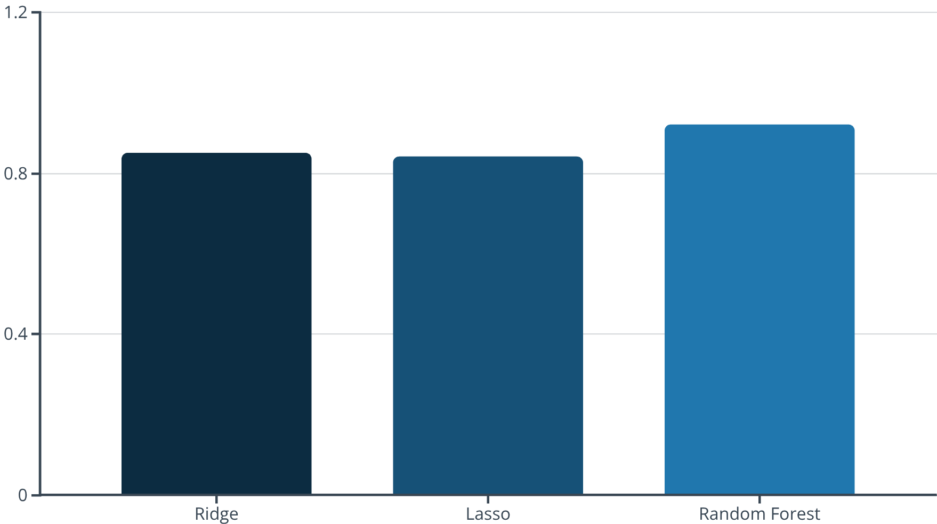
RESULTS
Model Evaluation & Performance
Performance Metrics
We evaluated our models using industry-standard metrics to ensure accuracy and reliability:
Mean Absolute Error (MAE): Measures average prediction error
Root Mean Squared Error (RMSE): Penalizes larger errors more heavily
R² Score: Explains variance in diamond prices
Model robustness was confirmed through rigorous k-fold cross-validation, ensuring consistent performance across different data subsets.
Top Performer
Key Insights
Random Forest achieved an impressive R² of 0.92, significantly outperforming regularization approaches
Feature importance analysis revealed carat weight and clarity as the strongest predictors of diamond value

Slide 7




INNOVATION
Market Gap & Research Opportunity
Industry Challenges
The diamond industry faces a critical gap in accessible, automated grading solutions. Current systems either rely on expensive specialized equipment or fail to capture the complex feature interactions that determine true diamond value.
Our Solution's Impact
Diamond Grader offers a scalable, cost-effective valuation tool that democratizes access to accurate gem assessment for jewelers, wholesalers, and consumers alike.
Retail Integration
Blockchain Future
Market Expansion
Instant pricing for jewelers and customers
Transparent certification and provenance tracking
Standardized valuation across global markets

Slide 8

Thank You
We appreciate your time and interest in Diamond Grader: Gem Valuator. Our team is excited about the potential to transform diamond valuation and bring transparency to the gem industry.
Questions and feedback are welcome!
Contact our team to learn more about our research, methodology, and future development plans.

